Slide 1
DETECTION OF BRAIN TUMOR IN
MEDICAL IMAGES
PRESENTED BY:
ABHINABA SAHA (ROLL-12201613001)

Slide 2
OUTLINE
INTRODUCTION
VARIOUS IMAGE PROCESSING TECHNIQUES
OVERVIEW OF THE APPROACH
STEPS OF THE APPROACH
TEST RESULTS
MORPHOLOGICAL OPERATIONS
FUTURE PROSPECTS
CONCLUSION

Slide 3
INTRODUCTION
Medical imaging is the technique and process of creating visual representations of the interior of a body for clinical analysis and medical intervention, as well as visual representation of the function of some organs or tissues (physiology).
PURPOSE: ESTABLISHES A DATABASE OF NORMAL ANATOMY AND PHYSIOLOGY TO MAKE IT POSSIBLE TO IDENTIFY ABNORMALITIES
MODALITIES: RADIOGRAPHY, MRI, NUCLEAR MEDICINE, ULTRASOUND, ELASTOGRAPHY, TACTILE IMAGING, PHOTOACOUSTIC IMAGING, TOMOGRAPHY, ECHOCARDIOGRAPHY, FUNCTIONAL NEAR-INFRARED SPECTROSCOPY, MAGNETIC PARTICLE IMAGING
TECHNIQUES: CONTRAST ENHANCEMNT, FILTERING, SEGMENTATION, CLUSTERING

Slide 4
VARIOUS IMAGE PROCESSING TECHNIQUES
FILTERING: USED FOR NOISE REMOVAL
CONTRAST ENHANCEMENT: IMPROVE THE VISUALIZATION OF THE MRI IMAGES
THRESHOLDING: IMAGE SEGMENTATION BY CONVERTING GRAYSCALE TO BINARY IMAGE
CLUSTERING AND SEGMENTATION: USED TO LOCATE OBJECTS AND BOUNDARIES
MORPHOLOGICAL OPERATION: USED FOR SHARPENING THE IMAGE

Slide 5
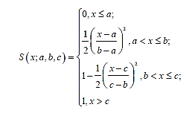

OVERVIEW OF THE APPROACH
FUZZY C-MEANS CLUSTERING
CALCULATING THE OPTIMUM THRESHOLD (INTER-CLUSTER THRESHOLD) THAT DISTINGUISHES BETWEEN THE AMBIGUOUS PIXELS AND NONAMBIGUOUS
The optimum threshold provides the global estimation of edge ambiguity.
USED MEMBERSHIP FUNCTION:
A membership function (MF) is a curve that defines how each point in the input space is mapped to a membership value (or degree of membership) between 0 and 1.

Slide 6
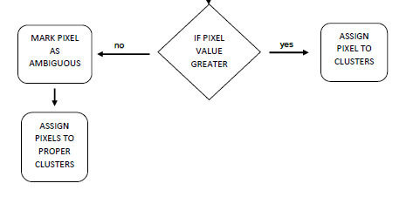
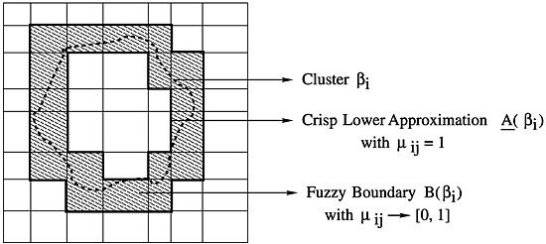
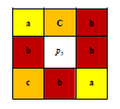
OVERVIEW OF THE APPROACH(contd..)
REVEALING AMBIGUOUS
PIXELS
LOCAL TREATMENT OF
AMBIGUOUS PIXELS: BY LINEAR SWEAPING
THE DATA IS AFFECTED TO THE MAJOR CLUSTER OF ITS NEIGHBORS. THUS THE WEAK PIXEL WILL BE ASSIGNED TO CLUSTER.
p1 | p2 | p3
p4 | p5 | p6
p7 | p8 | p9
3X3 window

Slide 7
STEPS OF THE APROACH
IMAGE TAKEN AS INPUT (HERE TAKEN IN IN JPG FORMAT)
CONVERTED TO GRAYSCALE
THRESHOLD IMAGE (HERE DONE BY OTSU’S METHOD)
CONTRAST ENHANCED BY CALCULATING THE IMAGE HISTOGRAM
IMAGE SEGMENTED BY MEMBERSHIP FUNCTION (BY FUZZY C MEANS CLUSTERING)
CLUSTER IDENTIFIED SHOWING THE TUMOR
OPTIMUM THRESHOLD CALCULATED THAT DISTINGUISHES BETWEEN AMBIGUOUS AND NON-AMBIGUOUS PIXELS
REVEALING AMBIGUOUS PIXELS
LOCAL TREATMENT OF AMBIGUOUS PIXELS
FINAL SEGMENTATION
MORPHOLOGICAL OPERATIONS

Slide 8
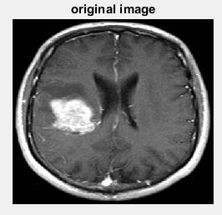
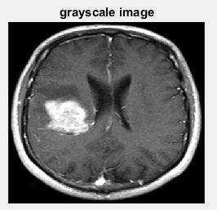
INPUT IMAGE
TEST RESULTS
GRAYSCALE IMAGE

Slide 9
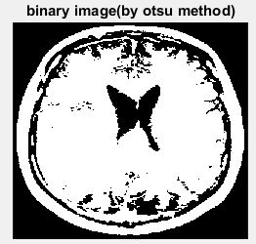
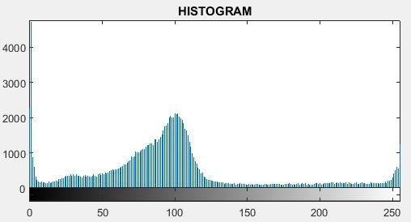
Threshold Image
Image Histogram Calculation

Slide 10
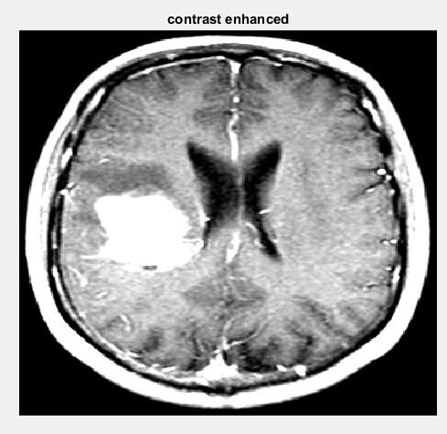
Contrast Enhanced By Image Histogram

Slide 11
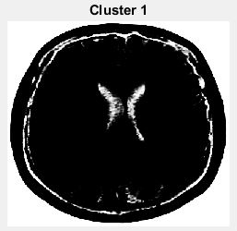
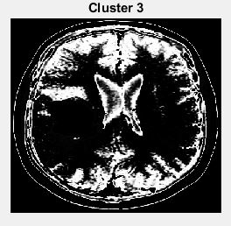
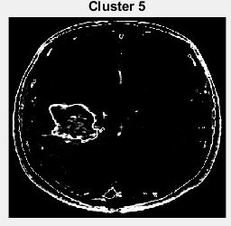
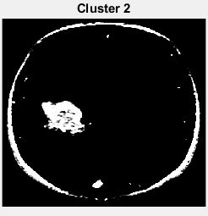
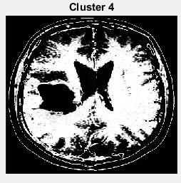
IMAGE SEGMENTED BY MEMBERSHIP FUNCTION (BY FUZZY C MEANS CLUSTERING)

Slide 12
Cluster Containing the Tumour

Slide 13
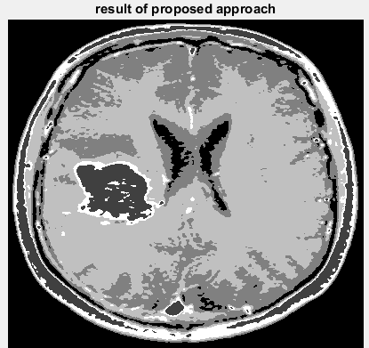
AFTER REASSIGNING AMBIGUOUS PIXEL

Slide 14
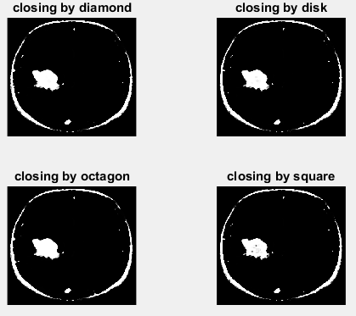
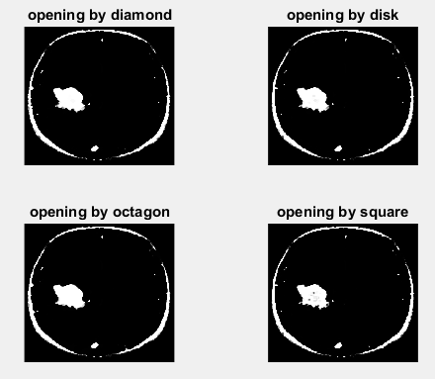
MORPHOLOGICAL OPERATIONS CLOSING OPERATIONS OPENING OPERATIONS

Slide 15
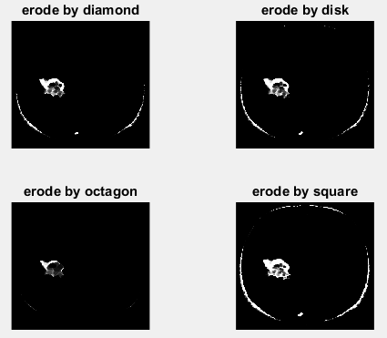
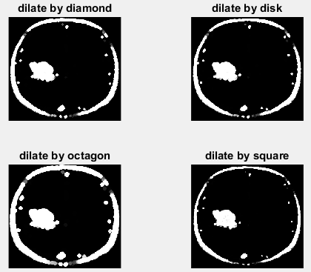
MORPHOLOGICAL OPERATIONS
ERODE OPERATIONS
DILATE OPERATIONS

Slide 16
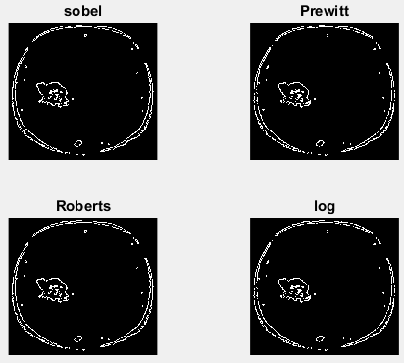
EDGE DETECTION

Slide 17
FUTURE PROSPECTS
SELECTING PROPER TREATMENTS
EASE OF ACCESS OF TREATMENT RESPONSES
IMPLEMENTATION OF THE PROPER DRUGS BECOMES
EASIER
CREATING 3D MODELS OF THE 2D IMAGES

Slide 18
CONCLUSIONS
Prompt and Rapid Actions can be taken
Accuracy Increased on Medical Analysis
Clustering help identifying heterogeneous cases
Early Detection Possible
Efficient Algorithms are still being worked out
Large Data –set handling always a concern

Slide 19
REFERENCE:
1) Abder-Rahman Ali, Adélaïde Albouy-Kissi, Manuel Grand-Brochier, Viviane Ladan-Marcus, “Liver Lesion Extraction with Fuzzy Thresholding in Contrast Enhanced Ultrasound Images” ,World Academy of Science, Engineering and Technology International Journal of Computer, Electrical, Automation, Control and Information Engineering Vol: 9, No: 7, 2015
2) Pankaj Kr. Saini, Mohinder Singh “BRAIN TUMOR DETECTION IN MEDICAL IMAGING USING MATLAB” e-ISSN: 2395-0056 Volume: 02 Issue: 02 | May-2015 www.irjet.net p-ISSN: 2395-0072.
3) AMRUTA PRAMOD HEBLI, SUDHA GUPTA “BRAIN TUMOR DETECTION USING IMAGE PROCESSING: A SURVEY” (Proceedings of 65th IRF International Conference, 20th November, 2016, Pune, India, ISBN: 978-93-86291-38-7.
4) Rohan K. Gajre, Savita A. Lothe, Santosh G.Vishwakarma “Identification of Brain Tumor using Image Processing Technique: Overviews of Methods” Published in SSRG International Journal of Computer Science and Engineering (SSRG-IJCSE) – volume 3 Issue 10–October 2016
5) P. Maji and S. Pal. “Maximum Class Separability for Rough-Fuzzy C Means
Based Brain MR Image Segmentation,” T. Rough Sets, Vol.9, pp.114-134, 2008.
6) H. Tizhoosh, “Image Thresholding Using Type II Fuzzy Sets,” Pattern Recognition. 38(12), 2363–2372, 2005.
7) Rohini Paul Joseph, C. Senthil Singh, M.Manikandan “BRAIN TUMOR MRI IMAGE SEGMENTATION AND DETECTION IN IMAGE PROCESSING”, IJRET: International Journal of Research in Engineering and Technology eISSN: 2319-1163 | pISSN: 2321-7308.
8) N. Otsu, "A Threshold Selection Method from Gray–level Histograms, "IEEE Trans. Sys., Man., Cyber. 9(1): 62–66. doi:10.1109/TSMC.1979.4310076, 1979.
9) Agus Zainal Arifin, Aidila Fitri Heddyanna, Hudan Studiawan, “Image Thresholding using Ultrafuzziness Optimization Based on Type II Fuzzy Sets”.

